Slide 1
Biochemically characterizing the Soluble guanylyl cyclase intrinsically disordered region
By: Candice Benally and Colleen Kelley
University of Massachusetts Lowell, Department of Chemistry and Biochemistry
Gage Lab

Slide 2
Nitric Oxide Pathway
Debshire, E. R., Marletta, M. A. Handb Exp Pharmacol. 191 (2009) 17-31
Notes:
Arginine (precursor) → NO, using enzyme: nitric oxide synthase
NO can pass through cell membrane into cytoplasm and stimulate sGC
Guanylate cyclase = enzyme for GTP → cGMP
↑cGMP (second messenger) activates PKG → causes vasodilation by process of phosphorylation

Slide 3
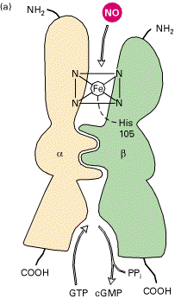
Soluble Guanylyl Cyclase
The IDR-HNOX 151AA in total.
The first 69 aa is the IDR followed by 76 aa of the HNOX domain
Debshire, E. R., Marletta, M. A. Handb Exp Pharmacol. 191 (2009) 17-31, Sharina, I. G., et. al. J. Biol. Chem. 2008, 283:15104-15113
Notes:
IDRs and IDP lack an ordered or fixed three-dimensional structure, i.e. random coils, multi-domained proteins connected by flexible linkers.
Despite lack of consistent structure, IDPs are functionally important and can adopt new conformations to carry out specific functions or regulation.

Slide 4
Possible protein-protein interaction sites with the idr sGC via prosite
1 25 48
Mus_musculus_IDR_HNOX MFCRKFKDLKITGECPFSLLAPGQVPKEPTEEVAGGSEGCQATLP-ICQY
Rattus_Norvegicus_IDR_HNOX MFCRKFKDLKITGECPFSLLAPGQVPTEPIEEVAGVSESCQATLP-TCQE
human_IDR_HNOX MFCTKLKDLKITGECPFSLLAPGQVPNESSEEAAGSSESCKATVP-ICQD
bos_taurus_IDR_HNOX MFCAKLKDLQITGDCPFSLLAPGQVPREPLGEATGSGPASTPGQPGVCPG
Manduca_Sexta_IDR_HNOX_Montf MTCP------FRRASSQHQFANGGSSAPKKPEFRSRTSSVHLTGP-----
* * : .. :* * . * . . *
60 69
Mus_musculus_IDR_HNOX FPEKNAEGSLPQRKTSRNRVYL
Rattus_Norvegicus_IDR_HNOX FAEN-AEGSHPQRKTSRNRVYL
human_IDR_HNOX IPEKNIQESLPQRKTSRSRVYL
bos_taurus_IDR_HNOX VPDKNPPGRLPRRKTSRSRVYL
Manduca_Sexta_IDR_HNOX_Montf EEEDGERNTLTLKHMSEALQLL
:. . :: *. *
* - single, fully conserved residue
: - conservation of strong groups
. - conservation of weak groups
- no consensus
Phosphorylation site
N-myristoylation site
____ Glycosylation site

Slide 5
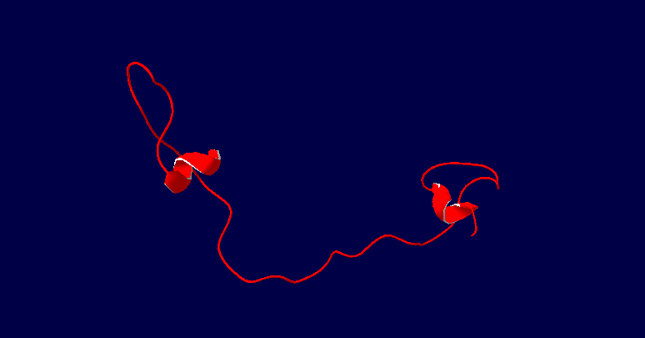
sGC-IDR Ribbon Structure
Structure obtained from http://bioinf.cs.ucl.ac.uk/psipred/?bioserf=1

Slide 6
Soluble Guanylyl Cyclase
The sGC α1 IDR does not affect the dimerization or catalytic activity of the enzyme
Splice variants of sGCα1 have been identified potential regulators of sGC catalytic activity.
Previous studies have identified other unique protein-protein interactions with the sGC β1 subunit and a phosphorylation site in the sGCα1.
sGC α1 subunit has been identified to interact with p53.
Chauhan, S. et al., Biochem J 2012, 446 (3), 445-53., Hanafy, K. A. et al. J Biol Chem 2004, 279 (45), 46946-53., Zhou, Z. et al. Arterioscler Thromb Vasc Biol 2008, 28 (10), 1803-10.
Cai, C. et al. Mol Endocrinol 2012, 26 (2), 292-307.

Slide 7
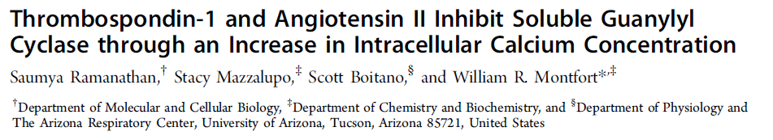

Slide 8
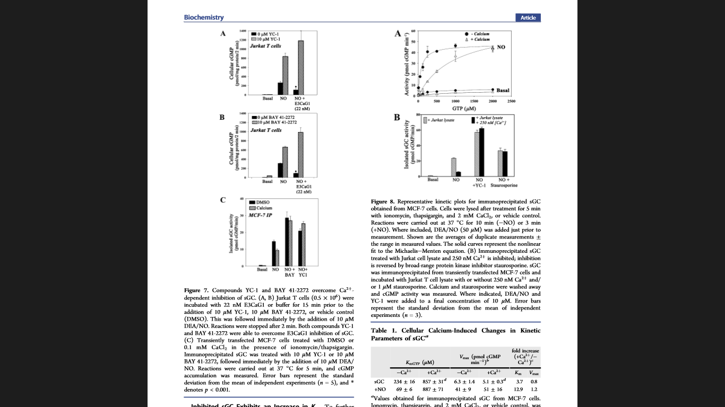
Montfort, et all:
Figure 8A. Kinetic Effects of Ca²⁺ and NO on cGMP production

Slide 9
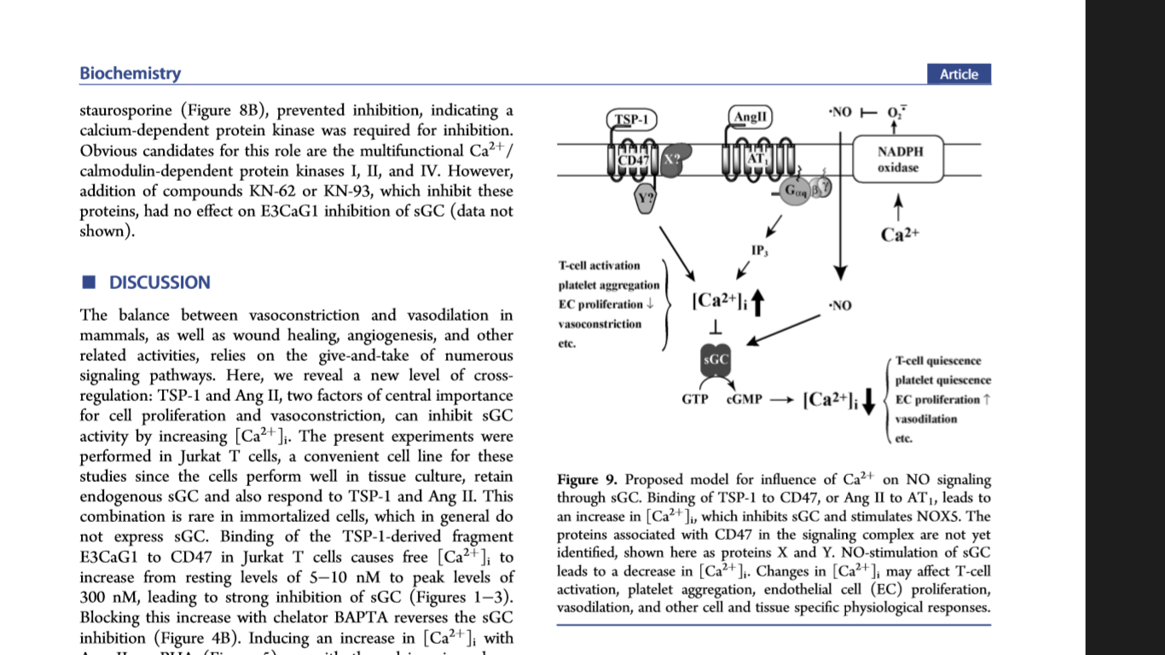
Montfort, et all:
Figure 9 – System Summary

Slide 10
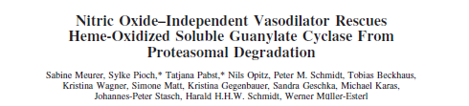

Slide 11
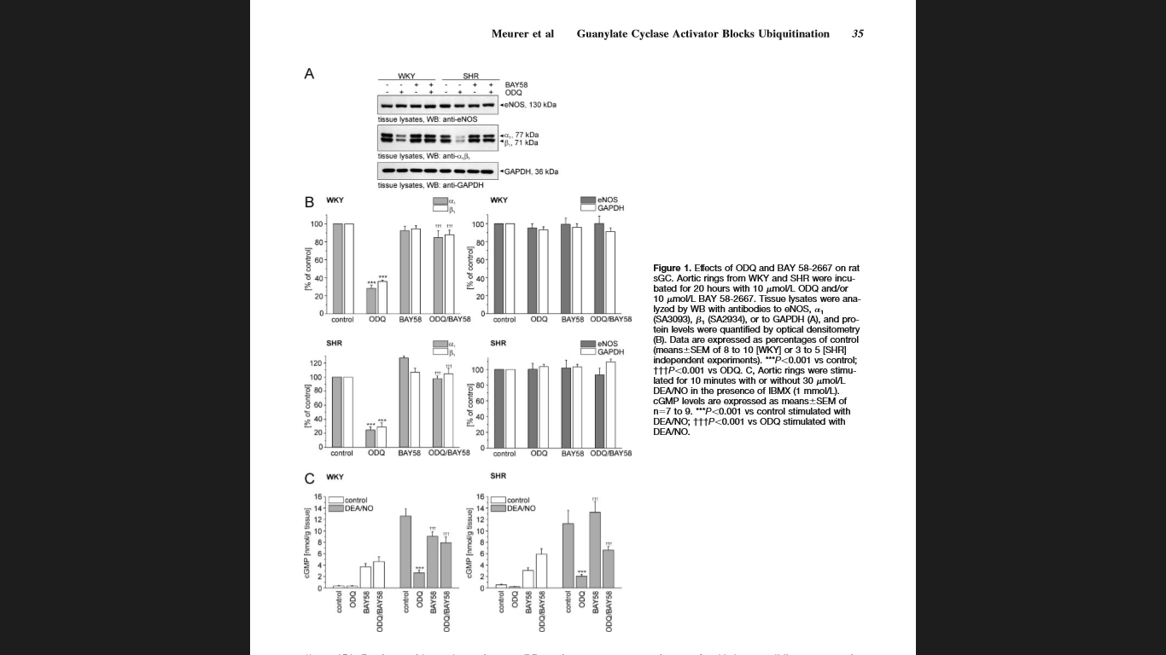
Meurer, et all:
Figure 1

Slide 12
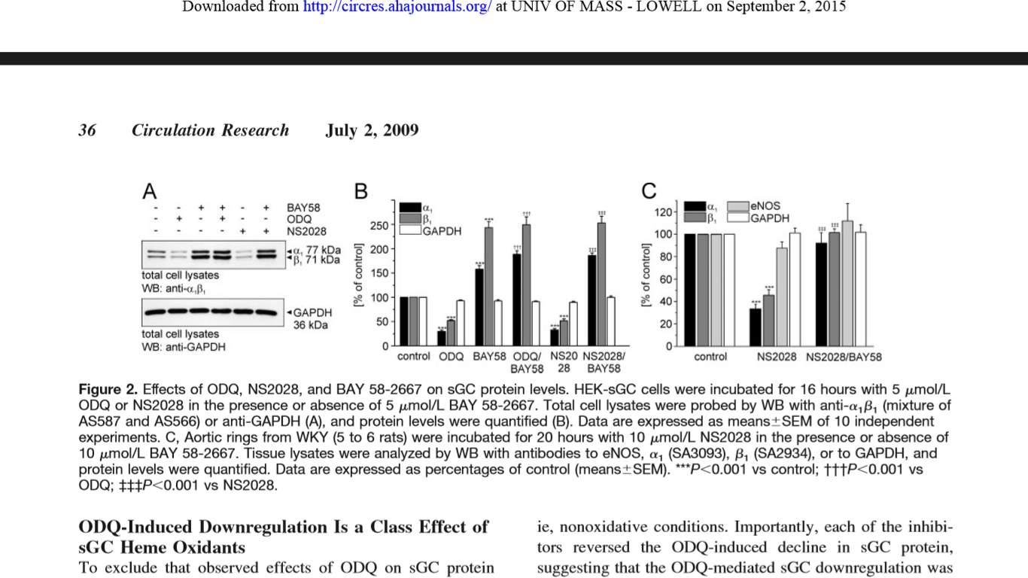
Meurer, et all:
Figure 2

Slide 13
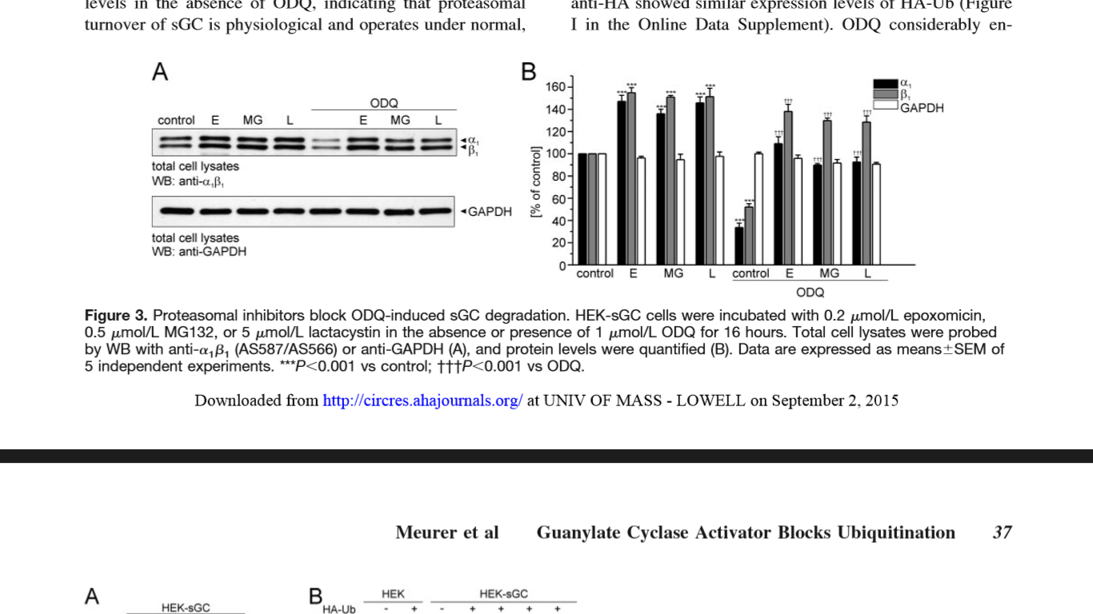
Meurer, et all:
Figure 3

Slide 14
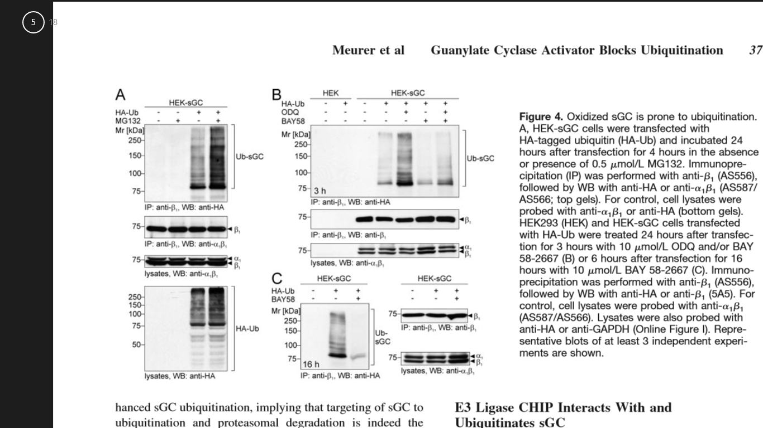
Meurer, et all:
Figure 4

Slide 15
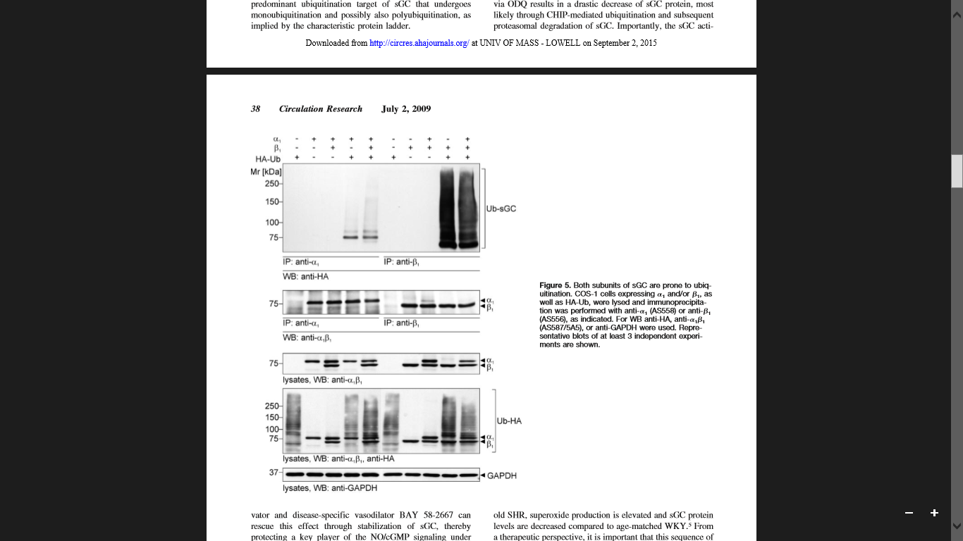
Meurer, et all:
Figure 5

Slide 16
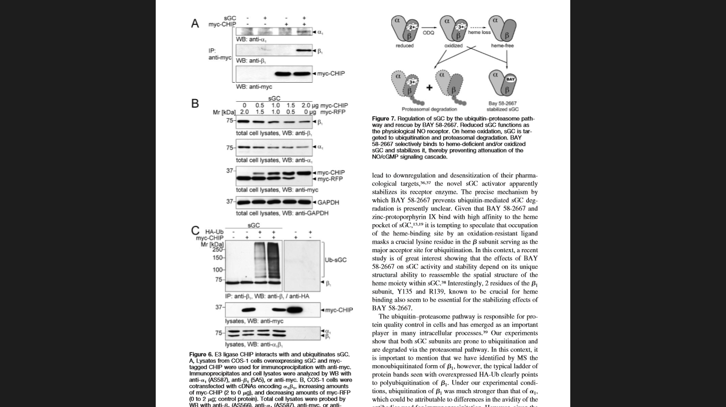
Meurer, et all:
Figure 6

Slide 17
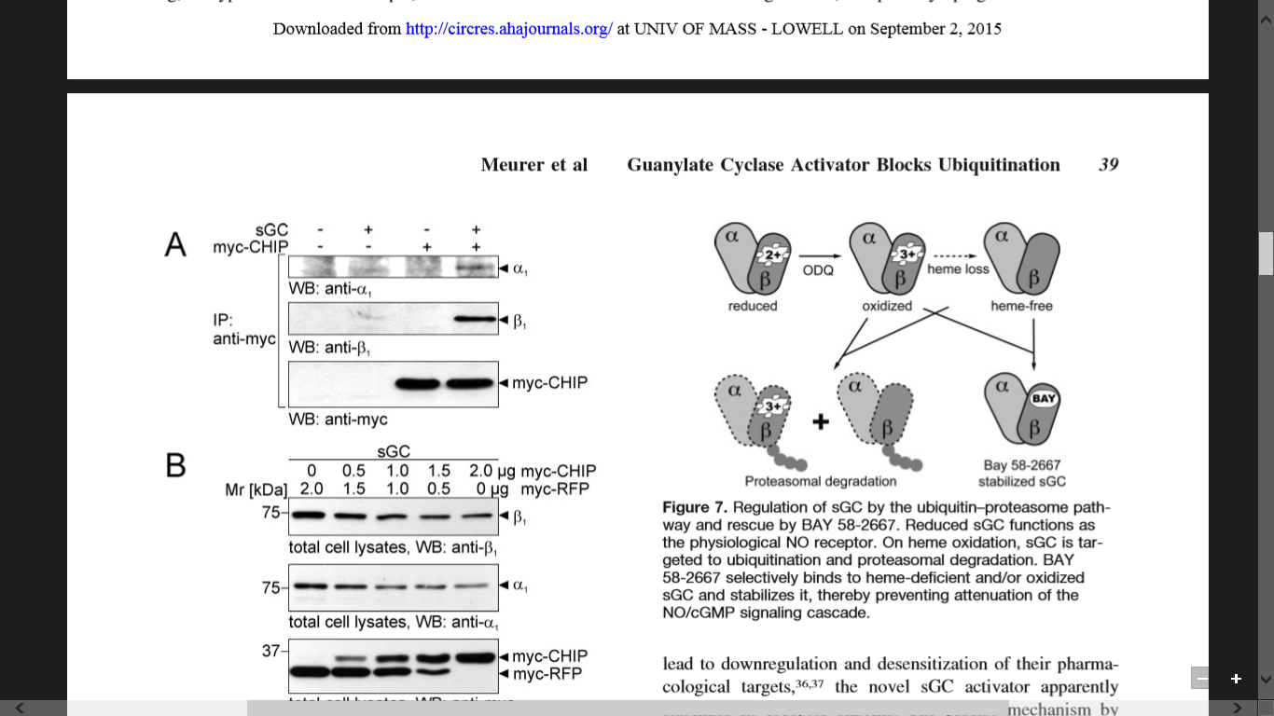
Meurer, et all:
Figure 7

Slide 18
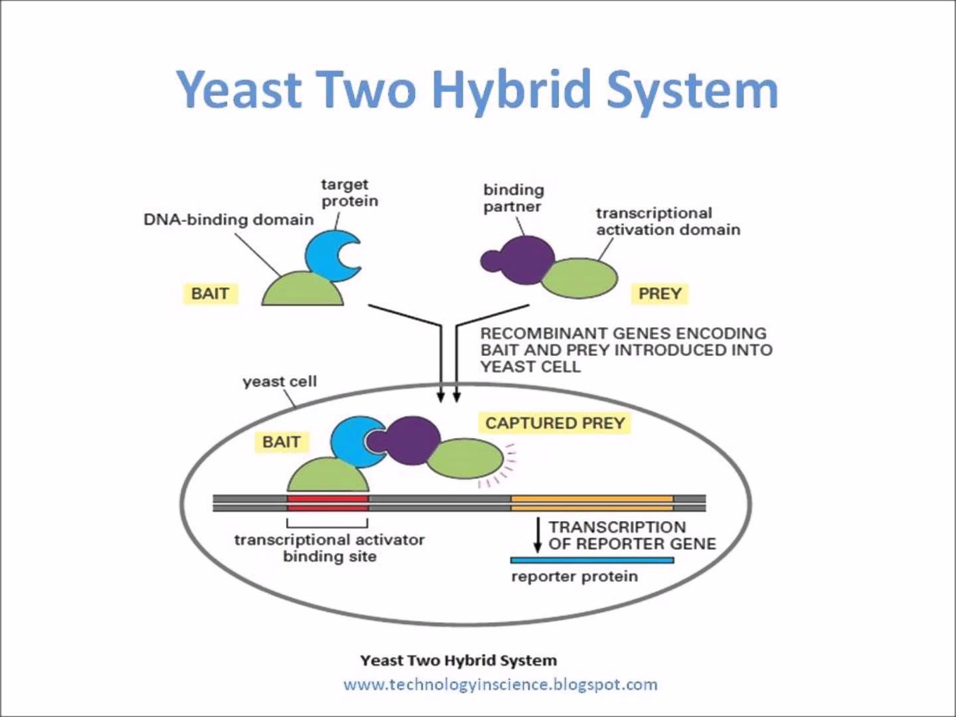
Yeast Two-Hybrid System
Identifying Protein-Protein Interaction

Slide 19
Yeast-two Hybrid Screen Identified Novel Protein-Protein
Interactions with sGCα1 IDR
Protein Identified | No. of clones ( total 85)
Titin (N2A Region) [Homo sapiens] | 16
hCG1983058 Elongation factor [Homo sapiens] | 10
E3 ubiquitin-protein ligase RING2 [Homo sapiens] | 53
chromosome-associated kinesin KIF4A isoform X1 [Homo sapiens] | 1
tryptophan synthase alpha chain [Escherichia coli] | 4
Junk | 1
Notes:
Based on these results, we are testing the binding of IDR with the N2A region of Titin and RNF2

Slide 20
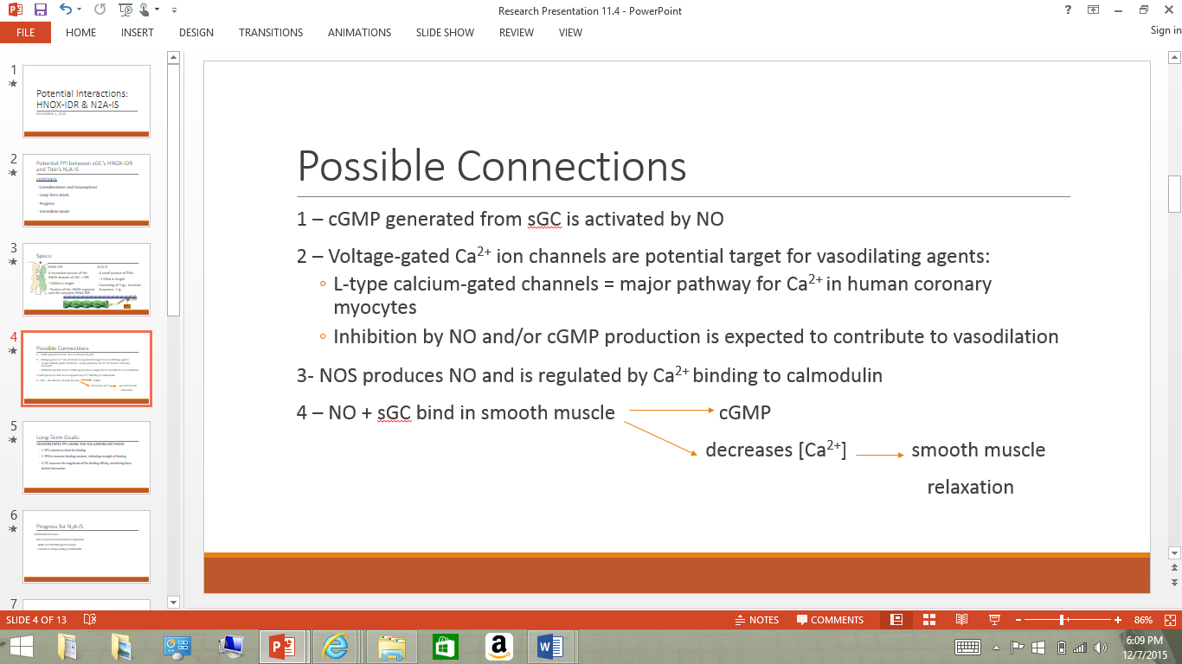
Possible Connections Between
IDR-HNOX & N2A-IS

Slide 21
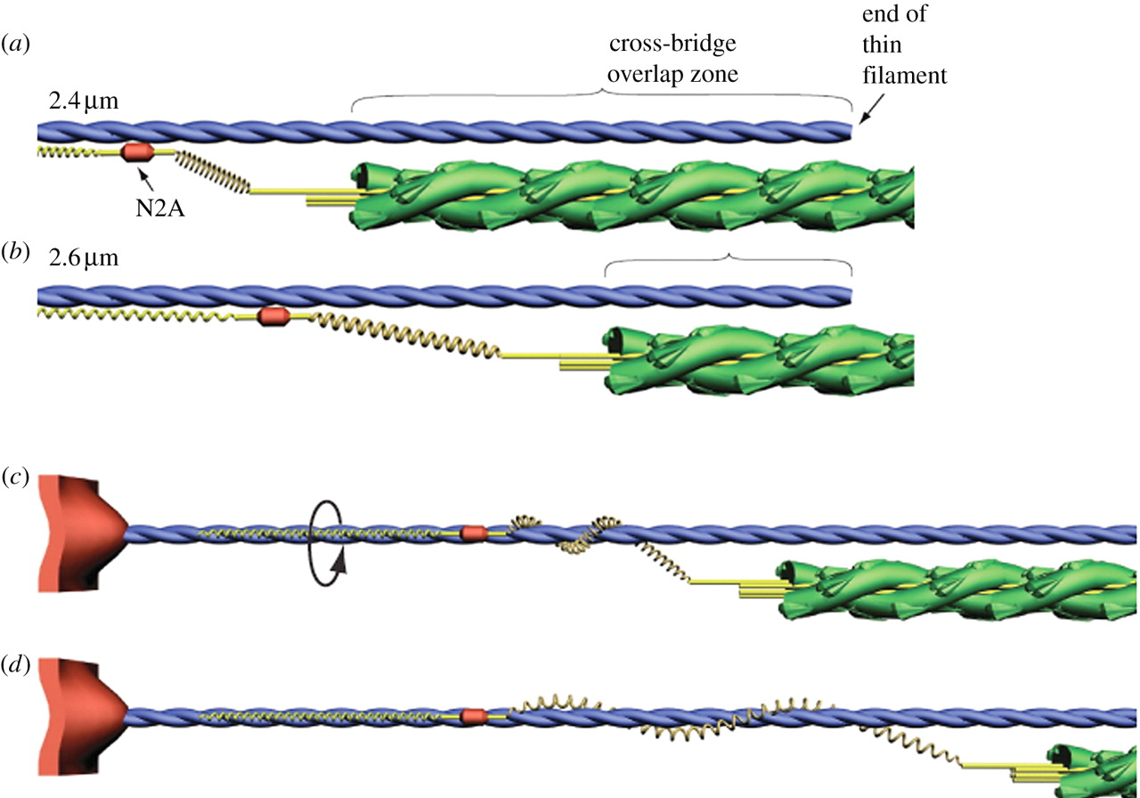
N2A
A small portion of Titin
~119AA in length
Consisting of 3 Igs, Insertion Sequence, 1 Ig

Slide 22
Progress for IDR-HNOX and N2A-IS binding
IDR-HNOX
N2A-IS
Recently obtained working plasmid
Expressed in pLysS cells
Purified with IMAC separation
Ran gel to show fractions
Purified with SEC
Ran one SEC binding test, another planned for tomorrow.
Expressed in pLysS and BL21
Purified with IEX separation
Ran purification gel
Purified with SEC
Ran one SEC binding test, another planned for tomorrow.

Slide 23
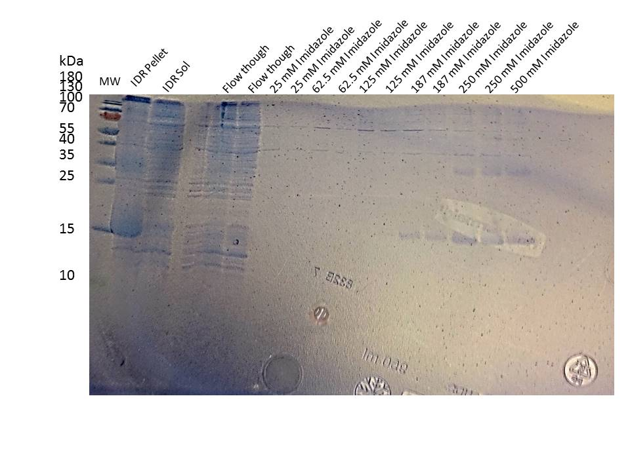
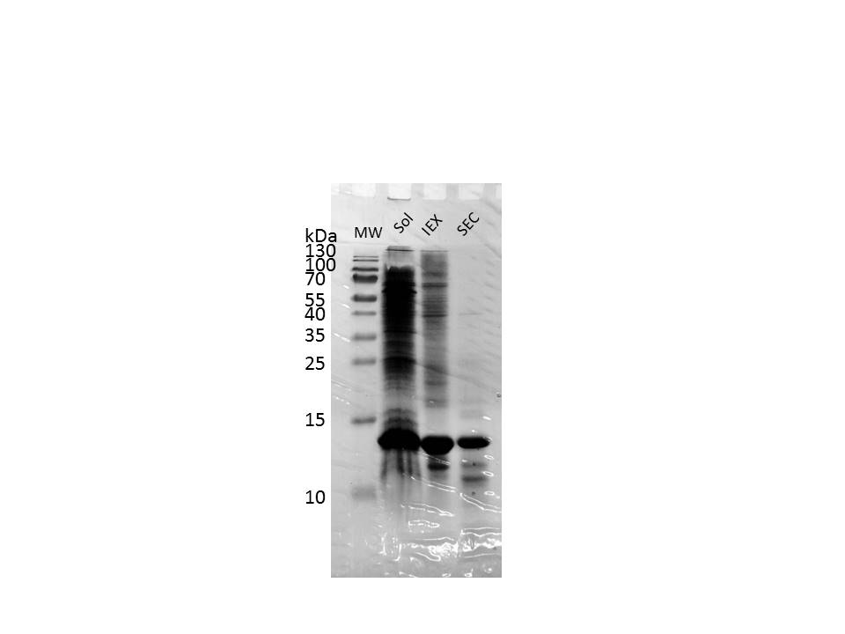
Purification Gels (IDR-HNOX & N2A-IS)
IDR-HNOX
N2A-IS
Notes:
HNOX-IDR came off with 187mM, 250mM and 500mM Imidazole
Higher molecular weight band = multimer?

Slide 24
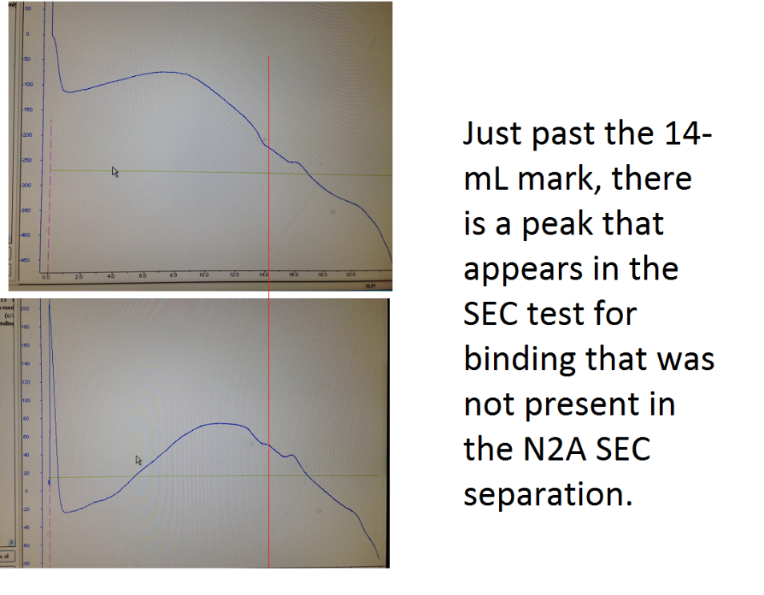
SEC Binding Test (IDR-HNOX & N2A-IS)
Notes:
40 uL of N2A-IS and 160 uL of HNOX-IDR (a sample from before that was not as clean, concentrated)

Slide 25
Long Term Plans
DEMONSTRATE PPI USING THE FOLLOWING METHODS
    1. SEC column to check for binding
    2. SPR to measure binding constant, indicating strength of binding
    3. ITC measure the magnitude of the binding affinity, and driving force behind interaction

Slide 26
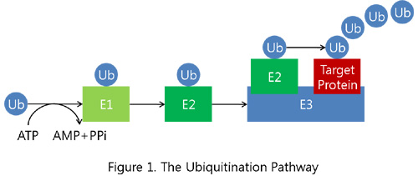
E3 ubiquitin-protein ligase RING2 (RNF2)
Gene regulation
  Mediates monoubiquitination of histone H2A
Forms complexes with other proteins to regulate gene expression
  Chromatin modification
Ubiquitinates protein for degradation.
Forms a dimer

Slide 27
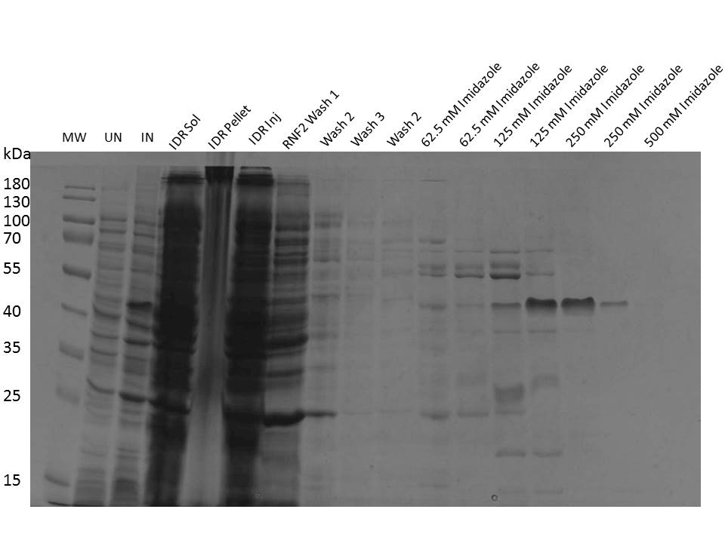
RNF2 purification

Slide 28
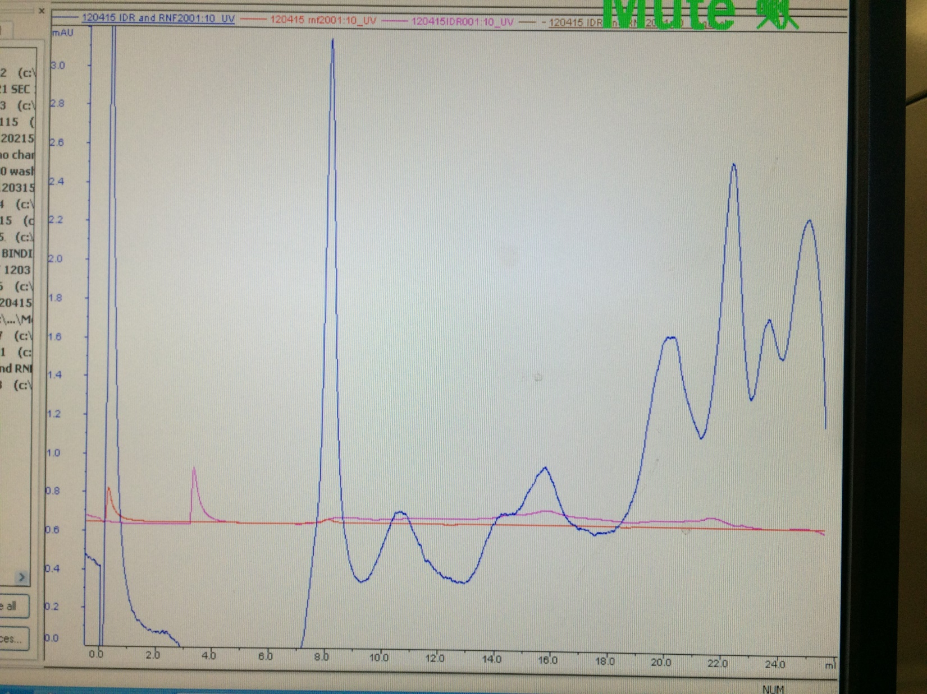
Initial SEC Binding Test
Blue- IDR+ RNF2
Red- RNF2
Pink- IDR

Slide 29
Future plans and long term plans
Experiments to confirm binding to RNF2
  Size exclusion chromatography to confirm binding.
  Isothermal titration calorimeter (ITC)
  SPR
Characterizing the protein-protein interaction
  Confirm RNF2 is responsible for conjugating ubiquitination of the IDR
  Screen for specific E2 interaction with IDR/RNF2 conjugate
  Mass spectroscopy to identify binding sites

